Slide 1

Securing Critical Assets Through Visibility
Asset Management and Security Knowing What we have Protecting what matters
Notes:
---

Slide 2

Agenda & Goal
Building stronger asset management
Improving asset control and value
Driving smarter asset decision
Creating resilient asset
Simplification agenda

Slide 3
Our asset landscape is growing more complex, while expectations for uptime, compliance, and security keep rising.
By improving visibility, prioritizing control, and using smarter monitoring, we can move from reactive fixes to confident decisions.
That shift gives leaders & business better resilience, lower risk, and a clearer path to value creation.
Visibility → Control → Confidence

Slide 4

Why Asset Management Is a Strategic Imperative
Expanding IT Complexity
  Modern environments: cloud, SaaS, remote work, and operational technology are expanding the asset landscape and increasing management complexity.
Consequences of Weak Control
  Poor asset management: drives equipment failures, financial exposure, cybersecurity risk, and compliance breakdowns.
The Strategic Value of Asset Management
  Strong asset management brings structure to complexity, sharpens risk prioritization, and aligns security decisions with business objectives.

Slide 5
The Price of Poor Asset Visibility and Control
Operational Disruption and Downtime
  Poor asset visibility drives operational breakdowns and costly downtime across tightly coupled production environments.
Exposure from Unknown Assets
  Untracked assets create unmanaged security exposure and easy entry points for attackers.
Compliance and Audit Pressure
  Weak asset control complicates compliance, raising the risk of penalties and reputational damage.
Productivity Loss and Strategic Drag
  Poor asset management wastes time and limits agility, undermining confident leadership decisions.

Slide 6

Minor Gaps, Major Consequences
Unmanaged Device Exposure
  Risk: Connecting unvetted devices to operational networks creates malware exposure and opens the door to security compromise.
Operational Spillover
  Impact: Malware can move laterally into critical systems, disrupting operations and forcing emergency shutdowns.
Response Friction
  Challenge: Incomplete asset inventories slow investigation, containment, and recovery.
Asset Visibility Matters
  Value: Proactive asset visibility and control reduce security incidents and limit operational disruption.

Slide 7

Four Pillars for Protecting What Matters
Visibility Foundation
  Complete visibility establishes a clear view of assets across IT, OT, cloud, and third-party environments.
Risk Prioritization
  Focused risk management ranks critical, exposed assets so resources are directed where they matter most.
Security and Resilience
  Resilient controls strengthen protection against threats and enable faster recovery from incidents.
Continuous Optimization
  Data-driven optimization uses automation and insight to improve asset management efficiency over time.

Slide 8

Enterprise-Wide Asset Visibility
Complete Asset Awareness
  Full-spectrum visibility requires current insight into hardware, software, data, identities, and services across every environment.
From Inventory to Insight
  True visibility includes configuration, health, ownership, lifecycle, and system connectivity for every asset.
Ownership Drives Accountability
  Clear ownership establishes accountability for security, maintenance, and lifecycle decisions, helping reduce risk.
Basis for Proactive Action
  Comprehensive visibility supports proactive security and operational decisions, reducing uncertainty and improving response.

Slide 9

Risk-Based Asset Priorities
Business-Aligned Asset Management
  Business alignment: Risk management directs asset efforts toward business priorities, concentrating resources on the assets most critical to safety and compliance.
Risk Assessment Factors
  Risk evaluation: Assessment weighs impact and likelihood across exposure, patch status, access pathways, and operational dependencies.
Prioritized Mitigation
  Mitigation focus: Organizations target high-risk assets first, strengthening controls and reducing exposure where consequences are greatest.
Value-Led Protection
  Strategic shift: Embedding risk management moves the organization from reactive response to strategic decision-making that balances cost, security, and continuity.

Slide 10

Secure Operations and Resilience
Preventive Security Controls: Access controls, network segmentation, and hardened configurations reduce breach risk across IT and OT environments.
Identity and Access Governance: Strong authentication and least-privilege access reduce misuse and contain the impact of compromised credentials.
Resilience and Incident Response: Clear playbooks, asset dependency insight, and recovery exercises enable rapid isolation and service restoration.
Security Embedded in Asset Management: Embedding security and resilience into asset management lowers incident impact and strengthens stakeholder confidence.

Slide 11
Optimization Through Data and Insight
Continuous Asset Enhancement
  Data and automation enable continuous gains in asset performance, resilience, and security across dynamic operating environments.
Predictive Maintenance Advantage
  Sensor analytics surface potential failures early, enabling planned maintenance that reduces disruption and downtime.
Performance Metric Visibility
Tracking availability and incident trends provides the insight needed for sharper, evidence-based asset decisions.
Optimization as an Operating Discipline
  Continuous optimization elevates asset management into a source of efficiency, adaptability, and sustained value.

Slide 12
Smart Factory Asset Visibility in Action
Unified Asset Monitoring
  Connected operations: Integrating machines, sensors, and control systems into one platform creates a real-time view of asset health and utilization.
Proactive Anomaly Detection
  Earlier intervention: Real-time visibility surfaces abnormal vibration and temperature patterns before they become equipment failures.
Smarter Maintenance Planning
  Better decisions: Reliable asset data improves maintenance execution and production planning while reducing unplanned stoppages.
Stronger Security and Coordination
  Risk visibility: Broader visibility helps flag unauthorized devices and network issues, lowering cyber risk and improving cross-team collaboration.

Slide 13

OT Cyber Risk Reduction in Practice
OT Security Challenges
  Core challenge: OT environments contend with legacy assets, proprietary protocols, and stringent uptime demands.
Passive Monitoring for Visibility
  Key outcome: Passive monitoring enabled asset discovery without disrupting operations, exposing outdated devices and vulnerabilities.
Targeted Risk Reduction
  Actions taken: Risk declined through prioritization of high-risk assets, network segmentation, tighter access controls, and governance of vendor connections.
Stronger Incident Response
  Operational benefit: Improved asset visibility strengthened incident response by clarifying dependencies and communication patterns.

Slide 14

Predictive Maintenance in Action
Sensor Monitoring
  Early-warning signals: Sensors track vibration, temperature, and load to surface early indicators of equipment failure.
Anomaly Detection Alerts
  Actionable alerts: Analytics detect anomalies and enable maintenance teams to plan timely intervention.
Operational Benefits
  Reduced disruption: Predictive maintenance cuts unplanned outages, lowers cost, and improves safety and reliability.
Data-Driven Asset Management
  Stronger decisions: High-quality asset data strengthens predictive maintenance and supports better business performance.

Slide 15

Next-Generation Asset Security and Management
AI-Driven Intelligence
  AI and machine learning enhance asset analysis, strengthen anomaly detection, and improve failure prediction with greater precision.
Digital Twin Modeling
  Digital twins enable teams to model asset behavior and test scenarios without operational disruption or real-world risk.
Cyber-Physical Resilience
  Security, reliability, and adaptability across connected digital and physical systems remain a strategic imperative.
Sustainable Stewardship
  Asset strategies are increasingly shaped by efficiency, waste reduction, and responsible environmental and social governance.

Slide 16
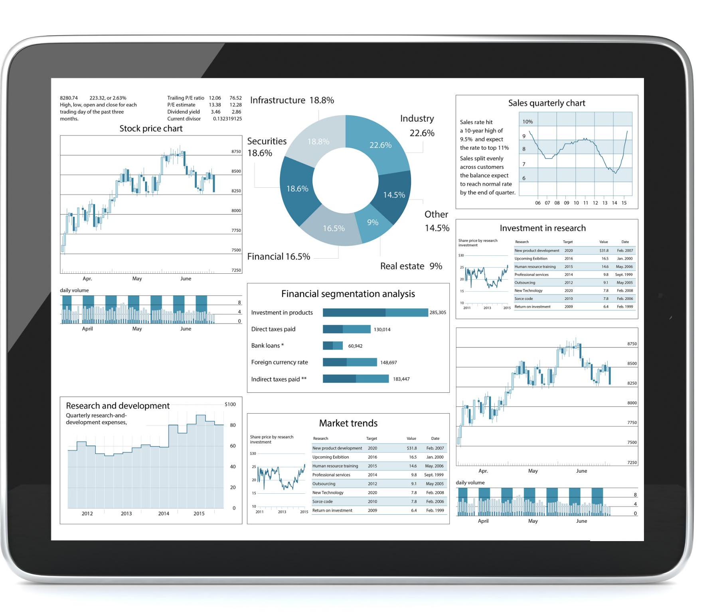
Measuring Asset Management Impact
Operational Performance
  Operational performance: Asset availability, downtime, and maintenance efficiency show how asset management improves day-to-day execution.
Security Resilience
  Security resilience: Monitoring unknown assets, patch coverage, and response times reduces exposure and strengthens control.
Strategic Alignment
  Strategic alignment: Metrics frame technical progress in business terms, enabling clearer leadership decisions and stronger alignment.

Slide 17

Executive Imperatives for Asset Security
Visibility Drives Control
  Visibility into assets is essential to stronger risk management and more effective protection across the enterprise.
Asset Management Strengthens Resilience
  Effective asset management enables faster incident response and recovery, improving organizational resilience.
Focus Resources on What Matters Most
  Prioritizing critical assets and risks sharpens resource allocation and reduces operational complexity.
Continuous Improvement Is Nonnegotiable
  Ongoing adaptation keeps asset management aligned with shifting business priorities and technology change.

Slide 18

Trust Through Resilience
  Protecting critical assets strengthens stakeholder confidence and improves resilience when disruption occurs.
Value at Risk
  Understanding asset value and exposure helps organizations reduce uncertainty and focus protection on what matters most.
Growth Enabled by Discipline
  Effective asset management creates the foundation for innovation and sustainable growth in a digitally transforming world.

Slide 19
Questions

